Slide 1
Making this resource work for you
Prior to teaching this lesson, please refer to the ‘Unit Overview and Planning Document’.
Further guidance on planning Science Mastery lessons can be found in the detailed planning guidance document.
Refer to the ‘notes’ section on each slide for useful information, including suggested expositions, pedagogical content knowledge, suggested questions, answers and more. Consider using presenter mode so you can see this guidance throughout the lesson.
The introduction slides can be adapted to suit your teaching style and the needs of your class.
Before the lesson, adapt the fix-it slide to address any misconceptions identified in the previous lesson’s exit ticket.
Choose from the suggested activities to suit your class. The intention is not that you complete all of these, but that you select those which ones are most appropriate for your students. It may be appropriate to further adapt activities for your students.
These lessons are designed to occupy approximately 1 hour. To adapt for a shorter or longer lesson duration we advise you to adapt the activity section accordingly.
Please consider using the final slide to send feedback about this lesson or examples of PowerPoints that you have adapted to our design team. Your feedback is used to improve Science Mastery for all of our teachers and students. We appreciate all suggestions and comments.
Thank you for reading!
The Science Mastery Team

Slide 2

Ionic Equations for the Reactions of Acids and Metals
Answer the questions below.
Define a ‘redox’ reaction.
How is an electron represented in a half equation?
What state symbol should be written next to the formula ‘Mg’ in an equation?
What state symbol should be written next to the ion ‘Mg²⁺’ in an equation?
State the ions that make up AgNO₃.
A redox reaction is one in which oxidation and reduction occur at the same time.
e⁻
(s)
(aq)
Ag⁺ NO₃⁻
Notes:
Big idea: Reactions Rearrange Matter

Slide 3
Ionic Equations for the Reactions of Acids and Metals
Do Now:
Define a ‘redox’ reaction.
How is an electron represented in a half equation?
What state symbol should be written next to the formula ‘Mg’ in an equation?
What state symbol should be written next to the ion ‘Mg²⁺’ in an equation?
State the ions that make up AgNO₃.
Drill:
State the ions present in sodium hydroxide.
Write the word equation for the reaction of sodium metal with water.
Write a balanced ionic equation for the same reaction.
Notes:
Answers:
Do Now:
1. A redox reaction is one in which oxidation and reduction occur at the same time.
2. e⁻
3. (s)
4. (aq)
5. Ag⁺ NO₃⁻
Drill:
Na⁺_{(aq)} and OH⁻_{(aq)}
sodium + water → sodium hydroxide + hydrogen
2Na_{(s)} + 2H₂O_{(l)} → 2Na⁺_{(aq)} + 2OH⁻_{(aq)} + H_{2(g)}

Slide 4
Ionic Equations for the Reactions of Acids and Metals
Read Now:
The main component of stomach acid is hydrochloric acid (HCl). Sometimes acid in the stomach is called ‘gastric acid’. This acid plays an important role in digestion and immunity. It helps to break down protein in your diet, absorb essential nutrients, and control viruses and bacteria that might otherwise infect your stomach. Gastric acid is produced by parietal cells in the stomach. A complex process results in both hydrogen ions (H+) and chloride ions (Cl-) being present in the stomach. These ions together form hydrochloric acid.
Name the main acid in the human stomach.
What is another name for acid in the stomach?
What are the functions of acid in the stomach?
Where is the acid in stomach produced?
What ions in the stomach join together to form hydrochloric acid?
Notes:
Answers:
Hydrochloric acid
Gastric acid
To break down proteins in food, absorb essential nutrients, control viruses and bacteria
Gastric acid is produced by the parietal cells in the stomach
Hydrogen ions and chloride ions

Slide 5

C4.2.6
18/03/2025
(HT) Ionic Equations for the Reactions of Acids and Metals
C4.2.1 PKR: Reactions of Metals
C4.2.2 Extracting Less Reactive Metals
C4.2.3 PKR: Ions, Ionic Bonding and Deducing Ionic Formulae
C4.2.4 (HT) Ionic Equations and Displacement Reactions
C4.2.5 (HT) Writing Half Equations
C4.2.6 (HT) Ionic Equations for the Reactions of Acids and Metals
C4.2.7 Introduction to Electrolysis
C4.2.8 Extracting Metals by Electrolysis
C4.2.9 Electrolysis of Molten Ionic Compounds
C4.2.10 Electrolysis in Solutions
C4.2.11RP: Electrolysis of Aqueous Solutions 1
C4.1.12 RP: Electrolysis of Aqueous Solutions 2
C4.1.13 TIF: Corrosion and its Prevention
C4.2.14 (HT) Obtaining Raw Materials
C4.2.15 Recycling Metals
C4.2.16 Feedback Lesson
Notes:
Big Idea: Reactions Rearrange Matter
Suggested Hook:
Ask students to write down what they can remember about the names and formulae of acids.
or
Add a piece of metal to a test tube of acid and observe the reaction. Ask students to describe what is happening.

Slide 6

Following this lesson, students will be able to:
Describe the reactions of acids and metals with chemical equations
Write ionic equations for the reactions of acids and metals
Write half equations for the reactions of acids and metals
Key Words:
hydrochloric acid
ionic equation
sulfuric acid
nitric acid
Notes:
Guidance:
See unit overview document and planning guidance to see how these objectives are typically assessed at GCSE, including examples of what students should be able to do following this lesson.
Planning for different needs:
The learning objectives given on this slide are suggested based on the most common requirements for exams, however they can be adapted based on the needs of different classes.
For best practice, the unit preparation booklet should be used to determine the appropriate focus of lessons within the unit.
While it is not possible to explicitly split content into levelled grades, we recommend that lesson objectives can be classified as critical, core or stretch.
Critical: the content or skill is essential for all students to be able to progress.
Core: the content or skill is important for students to progress, but other opportunities may be available to revisit it.
Stretch: the content or skill may not be essential for all students but is important for students aiming for the highest grades.
Key skill: this is a crucial skill being developed in this unit as part of the skill mapping
C4.2.6 Lesson Objectives:
Core: Describe the reactions of acids and metals with chemical equations
Core: Write ionic equations for the reactions of acids and metals
Core: Write half equations for the reactions of acids and metals

Slide 7
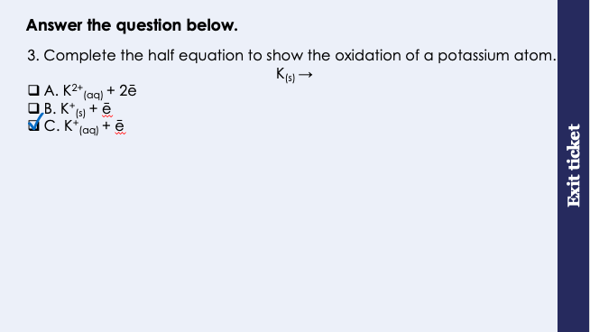
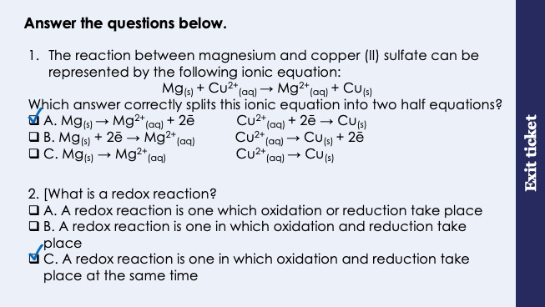
This is the fix-it portion of the lesson
The fix-it is an opportunity to respond to gaps in knowledge, especially those identified by the previous lesson’s exit ticket.
The teacher should customise this slide as needed, to facilitate
reteach, explanation, demonstration or modelling of ideas and concepts that students have not yet grasped or have misunderstood.
practise answering specific questions or of key skills.
redrafting or improving previous work.
Notes:
Fix-it guidance from previous exit ticket:
Q1. Answer: A
If students answer B, they are adding the electrons to the wring side of their half equations. To fix-it, take one side of the incorrect answer they have chosen here, for example ‘Mg + 2e’, ask students what charge magnesium would have if we added 2 electrons. The answer is negative, so this doesn’t make sense! Give students some more ionic equations to practise splitting up into ionic equations.
If students answer C, they have successful chosen the correct species to put into each of the half equations, however they have forgotten to represent the electrons. To fix-it, model the method for writing a half equation using a full ionic equation, and then give students some more ionic equations to practise splitting up into half equations.
Q2. Answer: C
If students answer A or B, students have selected a definition which is either incorrect or not specific enough to be correct. To fix-it, use an example of a redox reaction equation to show where oxidation and reduction are happening simultaneously to define a redox reaction. Ask students to repeat this definition from memory.
Q3. Answer: C
If students answer A, they have chosen the wrong number of electrons to oxidise a potassium ion. To fix-it, point out that potassium is in group 1 of the Periodic Table, and therefore it has 1 electron on its valence shell to lose readily. This means that potassium forms ions with a +1 charge, not +2. You can also reference the table of ionic formulae in the knowledge organiser.
If students answer B, they have deduced the correct ion formula for potassium, and have represented this correctly with 1 electron, however they have incorrectly written the state symbol as (s) for the potassium ion. To fix-it, remind students that ions appear in an aqueous state. Ask students to practice adding in the state symbols for a series of ionic and half equations.

Slide 8
Metals and acids react
When a metal reacts with an acid, a salt and hydrogen are made.
metal + acid → salt + hydrogen
There are three acids that you should know. Can you remember their chemical formulae? (Hint: all acids contain H)
Hydrochloric acid
Nitric acid
Sulfuric acid
When acids are added to water, they split up into their ions.
Can you state the ions that are in each of these acids?
HCl_{(aq)}
H⁺ Cl⁻
HNO_{3 (aq)}
H⁺ NO₃⁻
H₂SO_{4 (aq)}
2H⁺ SO₄²⁻
Notes:
Exposition type: Explanation
Students will have met the reaction between an acid and a metal before. There is an opportunity here to recap this in more detail by reminding students of how to name a salt using different acids, and giving them word equations to complete. This could be by filling in the blanks in word equations, and increasing the challenge to students constructing their own word equations given the reactants or products.
Model teacher exposition:
When a metal reacts with an acid, a salt and hydrogen are made.
We can write a general word equation to show this reaction, remembering that the reactants go on the left of the equation, and the products on the right: point to each part of the equation, reminding students of the link between which substances are reactants and products, and how we show that in equation form.
Take a test tube, acid, and some magnesium ribbon. Use a visualiser if available so that students can see what happens clearly on the screen (without getting up and crowding around). Carefully add the ribbon to the acid and give students a minute to observe carefully.
How do we know a chemical reaction is occurring here? We can see bubbles evolving.
What does this indicate to us? A gas is being produced.
A gas is a new product – a new substance is being produced here, so this is definitely a chemical reaction.
What do you think this gas is? Hydrogen gas.
Od course – because our equation here tells us that when we add a metal to an acid, we will be making a salt and hydrogen gas. At this point you could carry out the test for hydrogen to prove that it is in fact hydrogen gas being produced. Place your thumb over the mouth of the test tube and wait until you can feel the slight pressure of the gas building up Then, bring a lit splint to the mouth of the test tube. A squeaky pop indicates that hydrogen is present. This is not required knowledge for this lesson, but useful for students to see.
What other product is being produced here? A salt
We can see from our equation here that a salt and hydrogen has are produced. But, I can’t see a salt – my liquid still looks like it did in the beginning. Where is my salt? Is is dissolved in the liquid.
You have come across these acid names in year 8 and year 9 already. Can you remember their formulae? Remember, all acids contain hydrogen!
Give students time to write their answers and then display these for self assessment.
Now we are going to link this prior learning about acids to the more recent learning about ions and ionic equations. When acids are added to water, they split up into their ions. Use your list of ions handout to write down the ions that make up each of these acids.
Display the answers on the board once students have done this task, for self assessment. Check that for sulfuric acid, students have recognised that there are 2 hydrogen ions present. Students need to know these formulae by heart for the GCSE exams.

Slide 9
Use the general formula to predict the products of each reaction.
We can use the metal and the acid names to predict the salt that will form.
Hydrochloric acid forms salts ending in ‘chloride’
zinc + hydrochloric acid → zinc chloride + hydrogen
Nitric acid forms salts ending in ‘nitrate’
calcium + nitric acid → calcium nitrate + hydrogen
Sulfuric acid forms salts ending in ‘sulfate’
aluminium + sulfuric acid → aluminium sulfate + hydrogen
metal + acid → salt + hydrogen
Metal | Acid | Product 1 | Product 2
iron | hydrochloric acid
magnesium | sulfuric acid
sodium | nitric acid
lead |  | lead nitrate
iron chloride
hydrogen
magnesium sulfate
hydrogen
sodium nitrate
hydrogen
nitric acid
hydrogen
Notes:
Exposition type: Explanation
Model teacher exposition:
You may remember in year 8, you learned to predict the name of the salt formed when an acid and a metal react. Let’s recap some of the key knowledge that you need to do that again.
Read the top 3 sentences that state the name of the salt associated with each acid, and the example that goes with each.
For each example ask a student to state the metal name and acid name, and to explain why the products are as they are.
Now let’s use these rules to predict the products of some metal and acid reactions.
Bonus question! If I wanted to separate that salt from the liquid, what separation technique would I use? Distillation.

Slide 10
The reactions of acids with metals are redox reactions
Let’s look at an example.
The reaction between magnesium and hydrochloric acid can be represented by the word equation:
magnesium + hydrochloric acid → magnesium chloride + hydrogen
The chemical equation for this reaction is
Mg_{(s)} + 2HCl_{(aq)} → MgCl_{2(aq)} + H_{2(g)}
The ionic equation for this reaction is
Mg_{(s)} + 2H⁺_{(aq)} → Mg²⁺_{(aq)} + H_{2(g)}
The two half equations for this reaction are
Mg_{(s)} → Mg²⁺_{(aq)} + 2e⁻ (oxidation)
2H⁺_{(aq)} + 2e⁻ → H_{2(g)} (reduction)
Notes:
Exposition type: Explanation
Model teacher exposition:
Now we have recapped the reactions of metals and acids. You should be able to describe these reactions with word equations and predict the names of salts.
We will now link that prior learning to some of the more recent learning from this unit, about ionic equations and half equations.
The key point that you need to remember is: All reactions between metals and acids are redox reactions.
Can you remember what a redox reaction is? A redox reaction is one in which oxidation and reduction occur at the same time.
Remind me, what is oxidation (in terms of electrons)? Oxidation is the loss of electrons
And what is reduction (in terms of electrons)? Reduction is the gain of electrons.
So when we say that these reactions are redox reactions, we mean that something will be gaining electrons and something will be losing electrons at the same time.
What can you now do that will help us to show that oxidation and reduction are happening in this reaction? I can write half equations to show electrons being lost or gained.
So, let’s see if we can take this word equation for a reaction between an acid and metal, and find 2 half equations that demonstrate oxidation and reduction taking place.
Depending on the class, they may be able to suggest the steps here, based on the work completed in previous lessons.
First we need a balanced chemical equation for this reaction. We know magnesium is a solid, hydrochloric acid is HCl_{(aq)}, Magnesium chloride is MgCl_{2(aq)} and hydrogen gas is H₂. Give students some time to balance this equation and check against the one on this slide.
Now we will convert this chemical equation into an ionic equation. Model this process on the board, narrating your thinking process aloud, including removing the spectator ions.
Finally, we will write 2 half equations that represent this ionic equation. You can display the steps used from the previous lesson if needed here.
We can see that magnesium starts off as a neutral atom and then loses two electrons to become a positively charged ion – so magnesium is oxidised.
2 hydrogen ions gain 2 electrons to become a neutral hydrogen molecule, and so hydrogen is reduced.

Slide 11
The reactions of acids with metals are redox reactions
The reaction between zinc and hydrochloric acid can be represented by the word equation:
zinc + hydrochloric acid → zinc chloride + hydrogen
Show that this is a redox reaction.
The chemical equation for this reaction is
Zn_{(s)} + 2HCl_{(aq)} → ZnCl_{2(aq)} + H_{2(g)}
The ionic equation for this reaction is
Zn_{(s)} + 2H⁺_{(aq)} → Zn²⁺_{(aq)} + H_{2(g)}
The two half equations for this reaction are
Zn_{(s)} → Zn²⁺_{(aq)} + 2e⁻ (oxidation)
2H⁺_{(aq)} + 2e⁻ → H_{2(g)} (reduction)
This is a redox reaction because both oxidation and reduction are occurring at the same time.
Notes:
Exposition type: Explanation
Model teacher exposition:
Let’s see if we can follow the same process for another acid and metal reaction – zinc and hydrochloric acid.
Again, depending on the class, they may be able to suggest the steps here, based on the work completed on the previous slide and lessons.
First we need a balanced chemical equation for this reaction. We know zinc is a solid, hydrochloric acid is HCl_{(aq)}, Zinc chloride is ZnCl_{2(aq)} and hydrogen gas is H₂. Give students some time to balance this equation and check against the one on this slide.
Now we will convert this chemical equation into an ionic equation. Model this process on the board, narrating your thinking process aloud, including removing the spectator ions.
Finally, we will write 2 half equations that represent this ionic equation. You can display the steps used from the previous lesson if needed here.
We can see that zinc starts off as a neutral atom and then loses two electrons to become a positively charged ion – so zinc is oxidised.
2 hydrogen ions gain 2 electrons to become a neutral hydrogen molecule, and so hydrogen is reduced.
We can follow this process for any other acid and metal reactions.

Slide 12

Spot the error
The reaction between magnesium and sulfuric acid can be represented by the word equation:
magnesium + sulfuric acid → magnesium sulfate + hydrogen
The chemical equation for this reaction is:
Mg_{(s)} + H₂SO_{4(aq)} → MgSO_{4(aq)} + H_{2(g)}
The ionic equation for this reaction is:
Mg_{(s)} + H⁺_{(g)} → Mg²⁺_{(aq)} + H_{2(g)}
Notes:
The ionic equation is incorrect because there are two hydrogen ions in the sulfuric acid.
Suggested guidance:
Talk tasks can be used in a variety of ways to suit the particular needs of the students you are teaching. Through exchanging views with others, students develop their understanding of the science beyond what could be achieved individually.
Science classrooms that successfully integrate talk have the following features:
Science talk is a regular feature of lessons and is woven into classroom activities.
Students are paired or grouped strategically by the teacher to ensure productive interaction. This might take into consideration the students’ proficiency of the English language, how encouraging they might be to peers and their attainment in the topic. It’s a good idea to consider these pairings in the class seating plan.
Students are encouraged and supported to talk, but are not forced to talk.
The teacher should take on the role of a facilitator, engaging with conversations where necessary and encouraging or steering the conversation where needed.
Students are encouraged to use the language they have to express their ideas (e.g., everyday language, imperfect English, native language), but also to incorporate science specific terminology where this is more accurate or has been taught.
6. Scientifically inaccurate ideas are not dismissed by the partner or teacher; open discussion and further investigation are relied on to help students construct ideas that support them to progress in their scientific understanding.
7. Guidelines for behaviour during talk tasks are explicit and frequently reviewed. Rules for students might be:
Listen carefully to your partner
Take turns talking.
Speak one at a time, without interrupting.
Politely agree or disagree and explain why.
Politely point out if your partner has used a scientific word incorrectly, if they have explained the science incorrectly, or if there is a more accurate way to describe something.
If confused, ask questions.
Stay focused on the discussion topic.
Respond to one another.

Slide 13
Drill
Write a general equation for the reaction of an acid and a metal.
What gas is produced when acids react with metals?
State the formula for hydrochloric acid.
State the formula for nitric acid.
State the formula for sulfuric acid.
State the ions that make up hydrochloric acid.
Predict the products of a reaction between aluminium and nitric acid.
Define ‘redox reaction’.
Define oxidation in terms of electrons.
Define reduction in terms of electrons.
Notes:
Purpose: This is a knowledge drill. The purpose of this is to check that the critical knowledge is secure before pupils move onto independent practice.
Suggested guidance: There are a range of ways this could be done depending on time and ability range of the class:
Mini whiteboards
As full sentences in exercise books
As short answers in exercise books
In the pupil workbook
As pair talk
As cold call

Slide 14
Drill answers
acid + metal → salt + hydrogen
Hydrogen gas is produced when acids react with metals
HCl is the formula for hydrochloric acid
HNO₃ is the formula for nitric acid
H₂SO₄ is the formula for sulfuric acid
The ions in hydrochloric acid are H⁺ and Cl⁻
Aluminium and nitric acid would produce aluminium nitrate and hydrogen
A redox reaction is one in which oxidation and reduction occur at the same time
Oxidation is the loss of electrons
Reduction is the gain of electrons
Notes:
Purpose: This is a knowledge drill. The purpose of this is to check that the critical knowledge is secure before pupils move onto independent practice.
Suggested guidance: There are a range of ways this could be done depending on time and ability range of the class:
Mini whiteboards
As full sentences in exercise books
As short answers in exercise books
In the pupil workbook
As pair talk
As cold call

Slide 15
I: Writing half equations for acid and metal reactions
The chemical equation for a reaction between iron and sulfuric acid is:
Fe_{(s)} + H₂SO_{4(aq)} → FeSO_{4(aq)} + H_{2(g)}
1. Write an ionic equation for this reaction.
Fe_{(s)} + 2H⁺_{(aq)} → Fe²⁺_{(aq)} + H_{2(g)}
2. Write two half equations for this reaction.
oxidation
Fe_{(s)} → Fe²⁺ + 2e⁻
2H⁺_{(aq)} + 2e⁻ → H_{2(g)}
reduction
3. State which half equation demonstrates oxidation, and which demonstrates reduction.

Slide 16
We: Writing half equations for acid and metal reactions
The chemical equation for a reaction between zinc and sulfuric acid is:
Zn_{(s)} + H₂SO_{4(aq)} → ZnSO_{4(aq)} + H_{2(g)}
1. Write an ionic equation for this reaction.
Zn_{(s)} + 2H⁺_{(aq)} → Zn²⁺_{(aq)} + H_{2(g)}
2. Write two half equations for this reaction.
oxidation
Zn_{(s)} → Zn²⁺ + 2e⁻
2H⁺_{(aq)} + 2e⁻ → H_{2(g)}
reduction
3. State which half equation demonstrates oxidation, and which demonstrates reduction.

Slide 17
You: Writing half equations for acid and metal reactions
The chemical equation for a reaction between magnesium and sulfuric acid is:
Mg_{(s)} + H₂SO_{4(aq)} → MgSO_{4(aq)} + H_{2(g)}
1. Write an ionic equation for this reaction.
Mg_{(s)} + 2H⁺_{(aq)} → Mg²⁺_{(aq)} + H_{2(g)}
2. Write two half equations for this reaction.
oxidation
Mg_{(s)} → Mg²⁺ + 2e⁻
2H⁺_{(aq)} + 2e⁻ → H_{2(g)}
reduction
3. State which half equation demonstrates oxidation, and which demonstrates reduction.

Slide 18
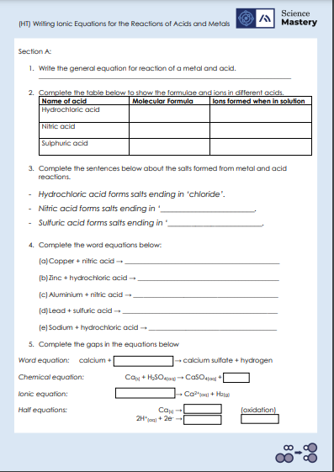
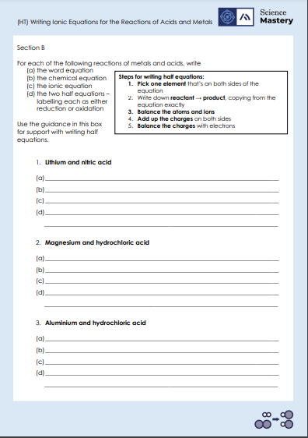
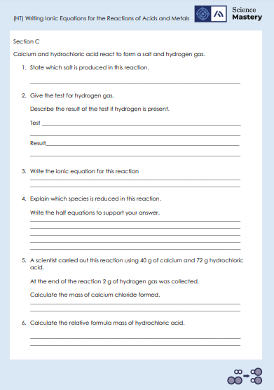
Activity

Slide 19
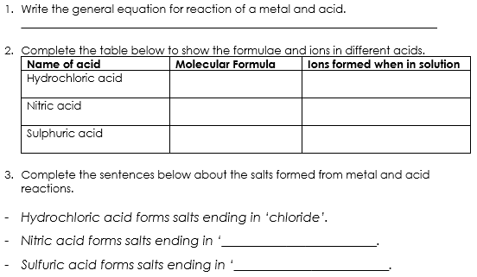
Section A - Answers
Metal + acid → salt + hydrogen
HCl
H⁺_{(aq)}
Cl⁻_{(aq)}
HNO₃
H⁺_{(aq)}
NO₃⁻_{(aq)}
H₂SO₄
2H⁺_{(aq)}
SO₄²⁻_{(aq)}
nitrate
sulfate

Slide 20
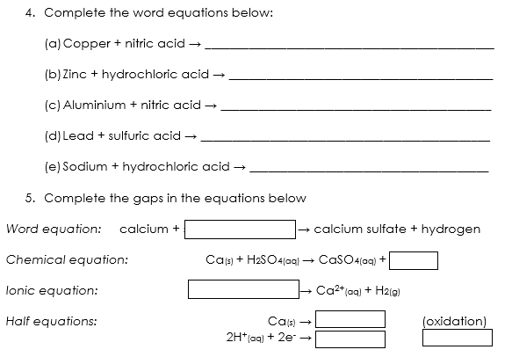
Section A - Answers
copper nitrate + hydrogen
zinc chloride + hydrogen
aluminium nitrate + hydrogen
lead sulfate + hydrogen
sodium chloride + hydrogen
hydrochloric acid
H_{2(g)}
Ca_{(s)} + 2H⁺_{(aq)}
Ca²⁺ + 2e⁻
H_{2(g)}
(reduction)

Slide 21
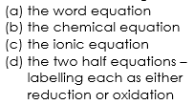
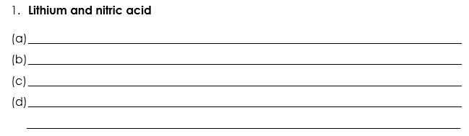
Section B - Answers
Lithium + nitric acid → lithium nitrate + hydrogen
2Li_{(s)} + 2HNO_{3(aq)} →2LiNO_{3 (aq)} + H_{2(g)}
2Li_{(s)} + 2H⁺_{(aq)} → 2Li⁺_{(aq)} + H_{2(g)}
2Li_{(s)} → 2Li⁺ + 2e⁻
2H⁺_{(aq)} + 2e⁻ → H_{2(g)}
oxidation
reduction

Slide 22
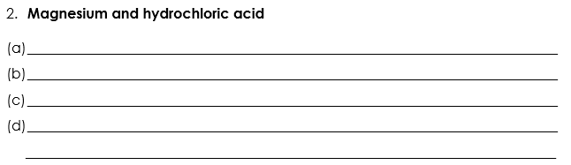
Section B - Answers
Magnesium + hydrochloric acid → magnesium chloride + hydrogen
Mg_{(s)} + 2HCl_{(aq)} →MgCl_{2 (aq)} + H_{2(g)}
Mg_{(s)} + 2H⁺_{(aq)} → Mg²⁺_{(aq)} + H_{2(g)}
oxidation
Mg_{(s)} → Mg²⁺ + 2e⁻
2H⁺_{(aq)} + 2e⁻ → H_{2(g)}
reduction

Slide 23
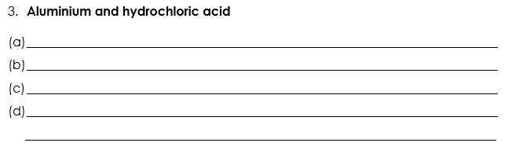
Section B - Answers
Aluminium + hydrochloric acid → aluminium chloride + hydrogen
2Al_{(s)} + 6HCl_{(aq)} →2AlCl_{3 (aq)} + 3H_{2(g)}
2Al_{(s)} + 6H⁺_{(aq)} → Al³⁺_{(aq)} + 3H_{2(g)}
Al_{(s)} → Mg³⁺ + 3e⁻
6H⁺_{(aq)} + 6e⁻ → 3H_{2(g)}
oxidation
reduction

Slide 24
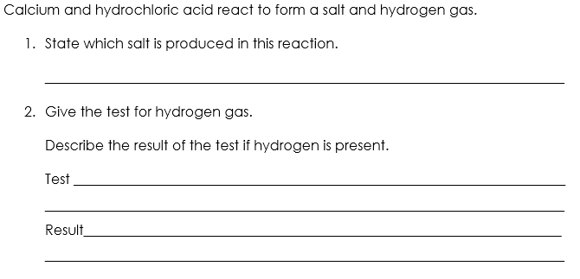
Section C - Answers
Calcium chloride
Squeaky pop test – place a lit splint in a sample of the gas
A squeaky pop sound will be produced

Slide 25
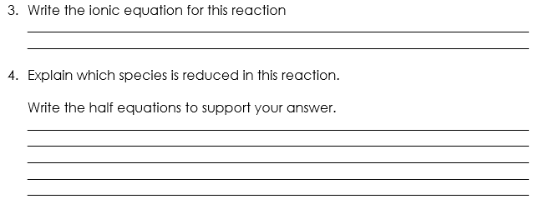
Section C - Answers
Ca_{(s)} + 2H⁺_{(aq)} → Ca²⁺_{(aq)} + H_{2(g)}
Calcium is losing electrons so is oxidised in this reaction.
Ca_{(s)} → Ca²⁺ + 2e⁻
2H⁺_{(aq)} + 2e⁻ → H_{2(g)}
Hydrogen ions are the species being reduced because they are gaining electrons.

Slide 26
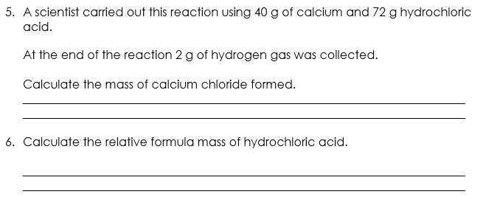
Section C - Answers
Mass of calcium chloride = mass of reactants – mass of hydrogen
Mass of calcium chloride = (40 + 72) – 2 = 110 g
RFM of HCl = 35.5 + 1 = 36.5
Notes:
40 + 72 = 102 kg

Slide 27
Answer the questions below.
Complete the half equation to show the electrons involved.
Al³⁺ _____ → Al
A. + e⁻
B. + 3e⁻
C. – e⁻
✓
2. What is the formula for a zinc ion?
A. Zn
B. Zn⁺
C. Zn²⁺
D. Zn⁻
✓
Notes:
Q1. Answer: B
If students answer A or C, they do not recognise that to neutralise an ion with a +3 charge, three electrons are required. To fix-it, explain to students that one positive charge and one negative charge (one electron) ‘cancel each other out’ to make a neutral atom. Therefore an ion with a charge of +3 will require 3 electrons to neutralise it. Give students a selection of ionic equations to complete to practise.
If students answer C, they have made the classic mistake of ‘taking away’ the electron by putting a ‘-’ instead of a ‘+’ in the equation. To fix-it, remind students that unlike mathematical expressions, chemical equations only always have + between the substances/species.
Q2. Answer: C
If students answer A, they do not know the difference between an atom and an ion. To fix-it, define the term –ion’ and give students examples of atoms and ions to sort.
If students answer B or D, they are unable to deduce the correct formula for an ion. To fix-it, remind students to refer to the table of common ions.

Slide 28
Answer the question below.
3. The reaction between magnesium and sulfuric acid can be represented by the word equation:
magnesium + sulfuric acid → magnesium sulfate + hydrogen.
The chemical equation for this reaction is:
Mg_{(s)} + H₂SO_{4(aq)} → MgSO_{4(aq)} + H_{2(g).}
What is the ionic equation for this reaction?
A. Mg_{(s)} → Mg²⁺_{(aq)} + 2e⁻, and 2H⁺_{(aq)} + 2e⁻ → H_{2(g)}
B. Mg_{(s)} + 2H_{(aq)} → Mg_{(aq)} + H_{(g)}
C. Mg_{(s)} + 2H⁺_{(aq)} → Mg²⁺_{(aq)} + H_{2(g)}
✓
Notes:
Q3. Answer: C
If students answer A, they have confused ionic equation with half equation. If students answer B, they have correctly eliminated the spectator ions from the equation but have chosen the option that does not include the correct charges for the ions. To fix-it, model for students the steps of writing an ionic equation from a full chemical equation. Give students some independent practice to do this themselves, using your model to guide them.

Slide 29
Lesson C4.2.6
What was good about this lesson? | What can we do to improve this lesson?
Send us your feedback by clicking this link
or by emailing sciencemastery@arkonline.org
Thank you!

